Slide 1
Insights for Camico
From Salesforce CRM Data

Slide 2
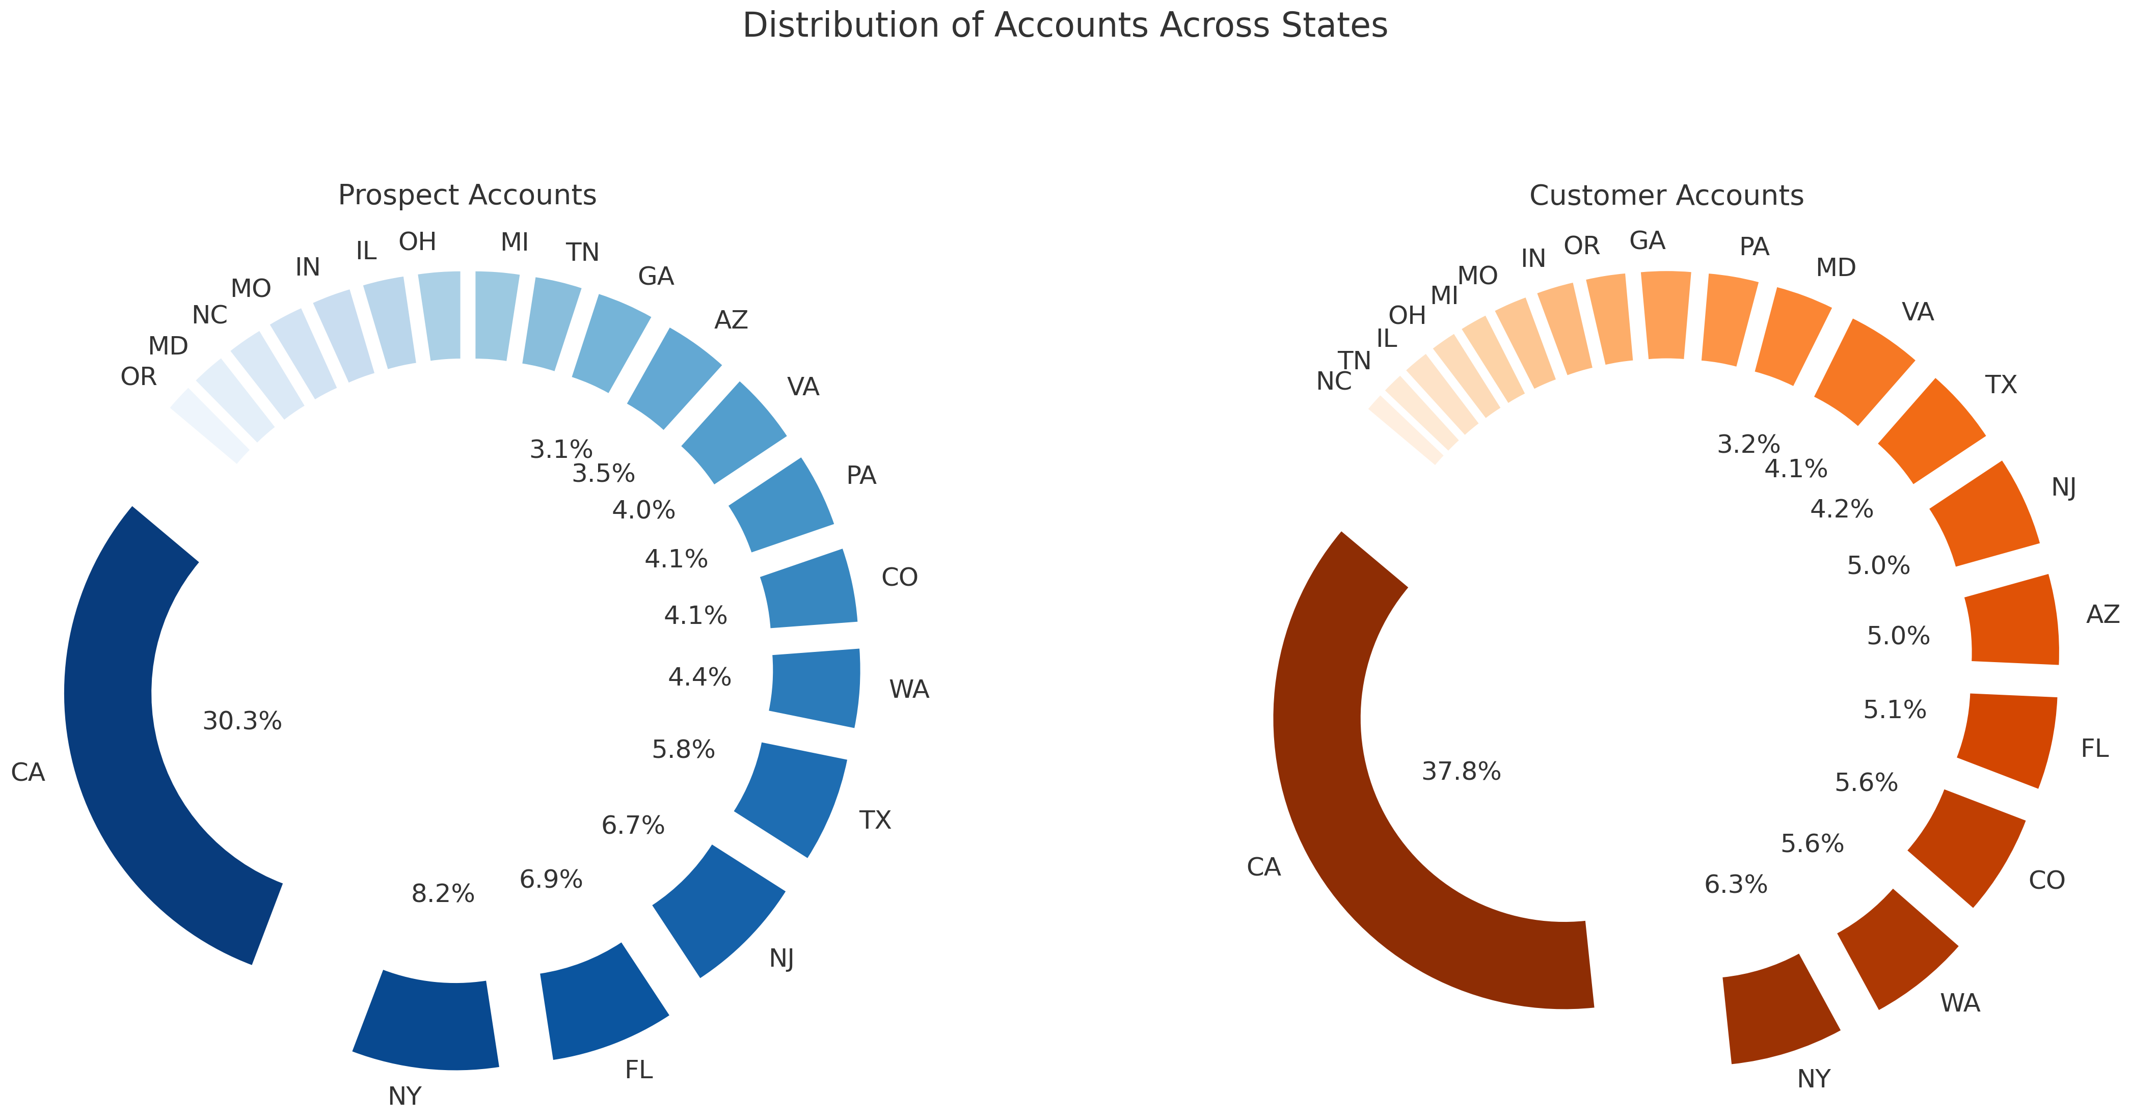
California Dominance: Both existing customer accounts and prospect accounts hold a dominance of California as Camico is based out of San Mateo, California
NY, NJ, WA, CO, FL and AZ hold significant customer bases
FL is a focus area and growth market

Slide 3
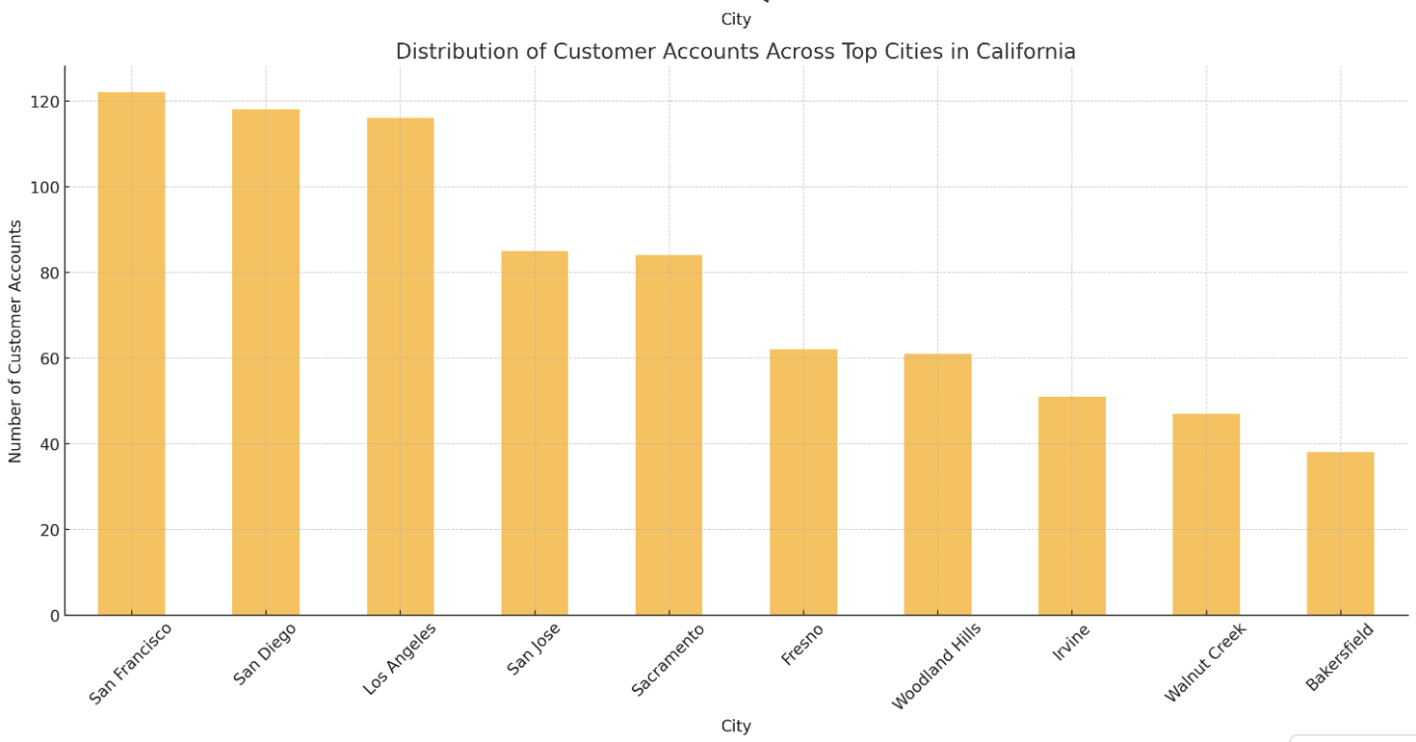
Primary Hubs: SF Bay Area, San Diego, LA
Distribution is top-heavy, bulk of customer accounts coming from three cities in CA
Strategy: Diversification strategy through predictive analytics towards emerging markets in Fresno, Woodland Hills and Irvine

Slide 4
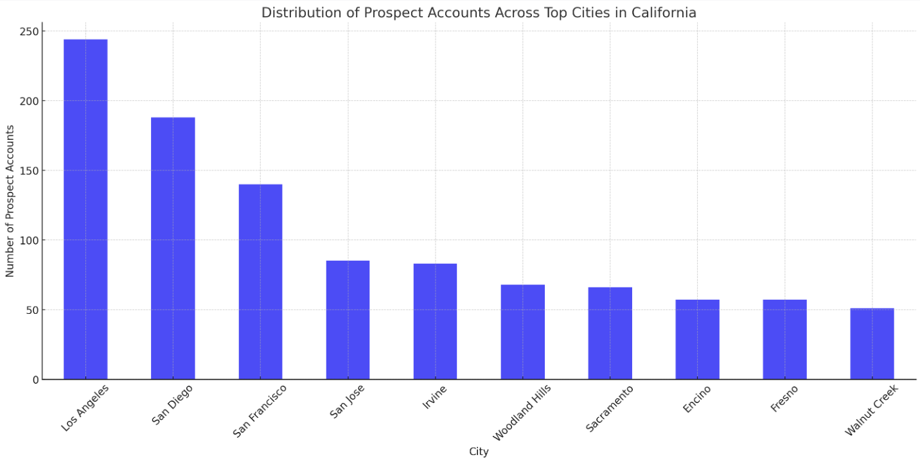
Focus remains in the same geographies, with LA, SD and SF Bay Area heavy
LA seems to be having additional market potential considering similar number of customer accounts but a lot more prospect accounts
Irvine seems to be having market potential in the emerging markets

Slide 5
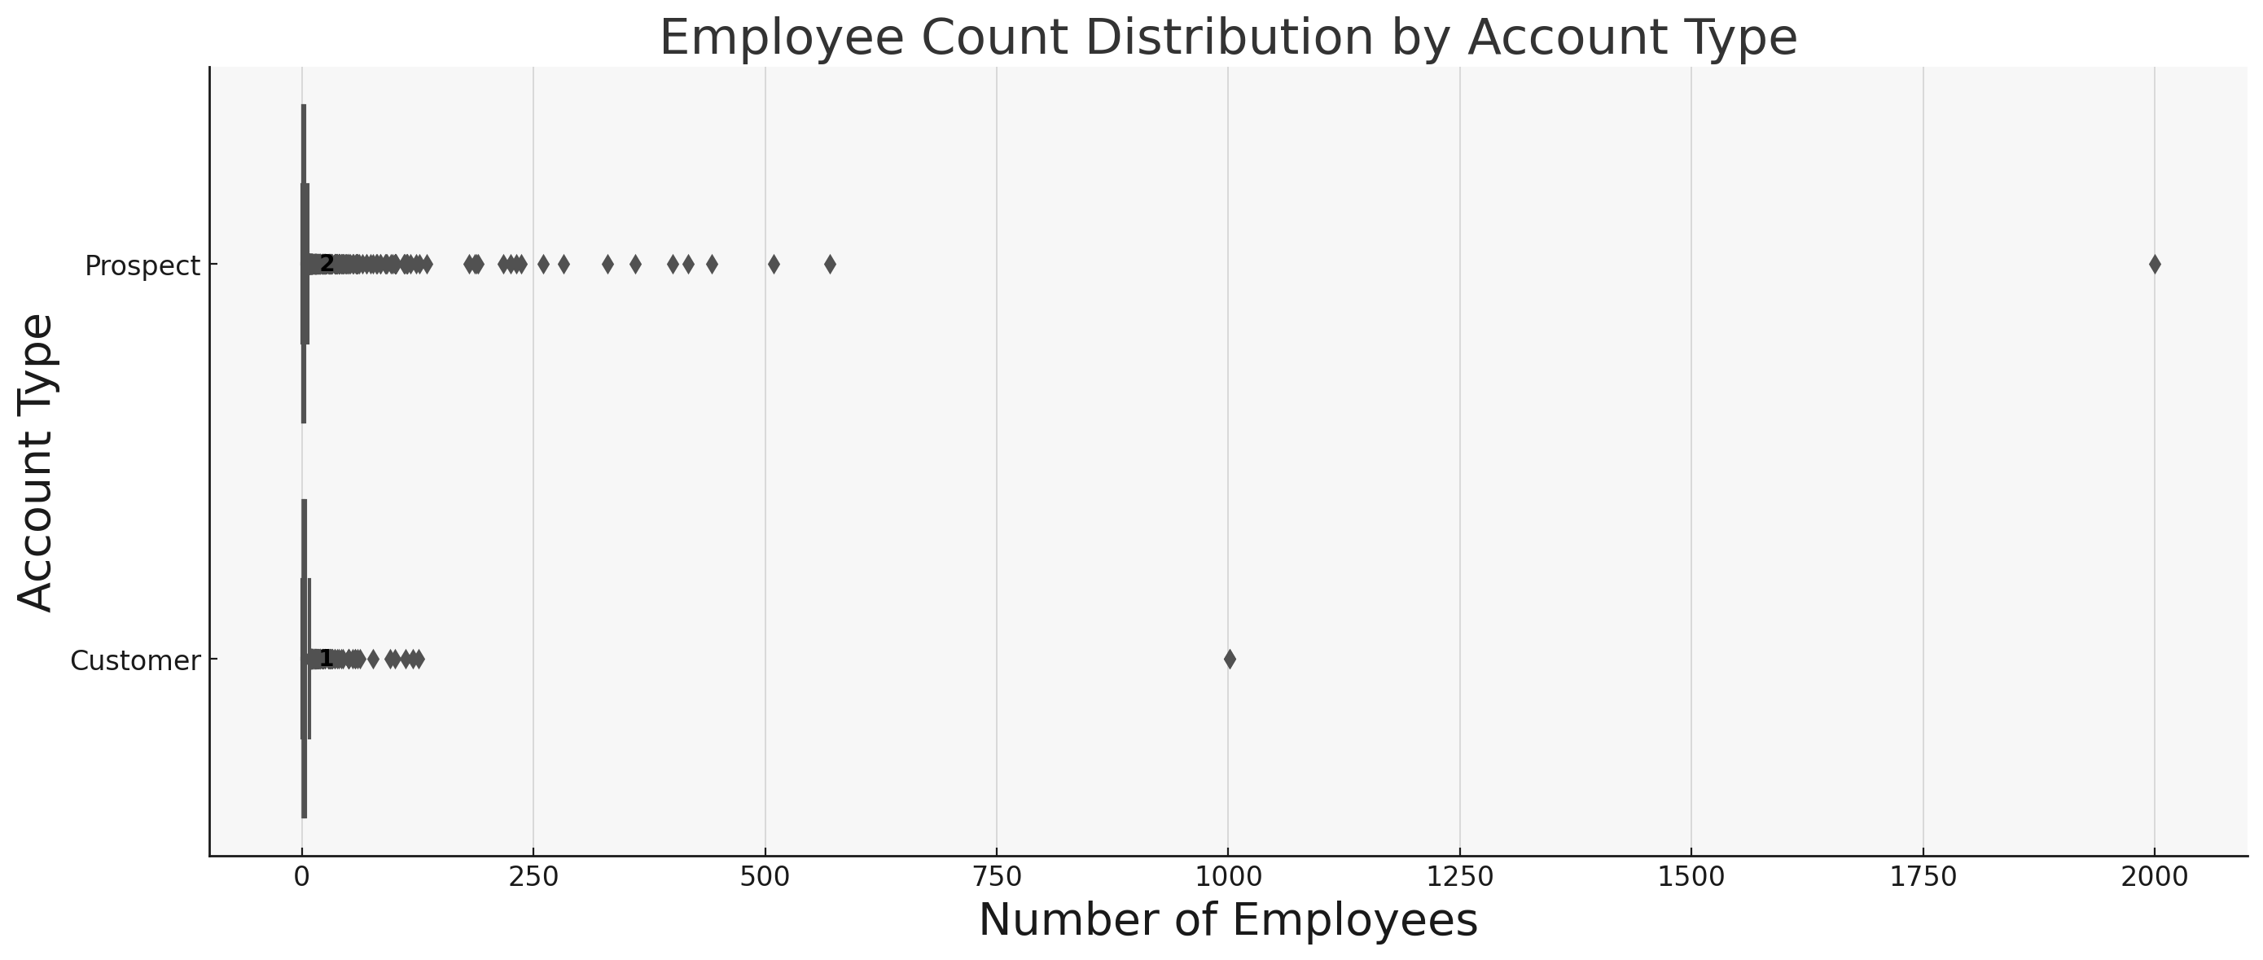
Prospect pool of accounts is widely spread in terms of number of employees, possibly reducing the conversion rate
Highly successful in converting medium-sized businesses into customers, but large organizations are not yet customers
Strategy Plan: High retention plan with medium-sized customers with a growth focus towards large organizations through prediction

Slide 6
Opportunity Insights

Slide 7
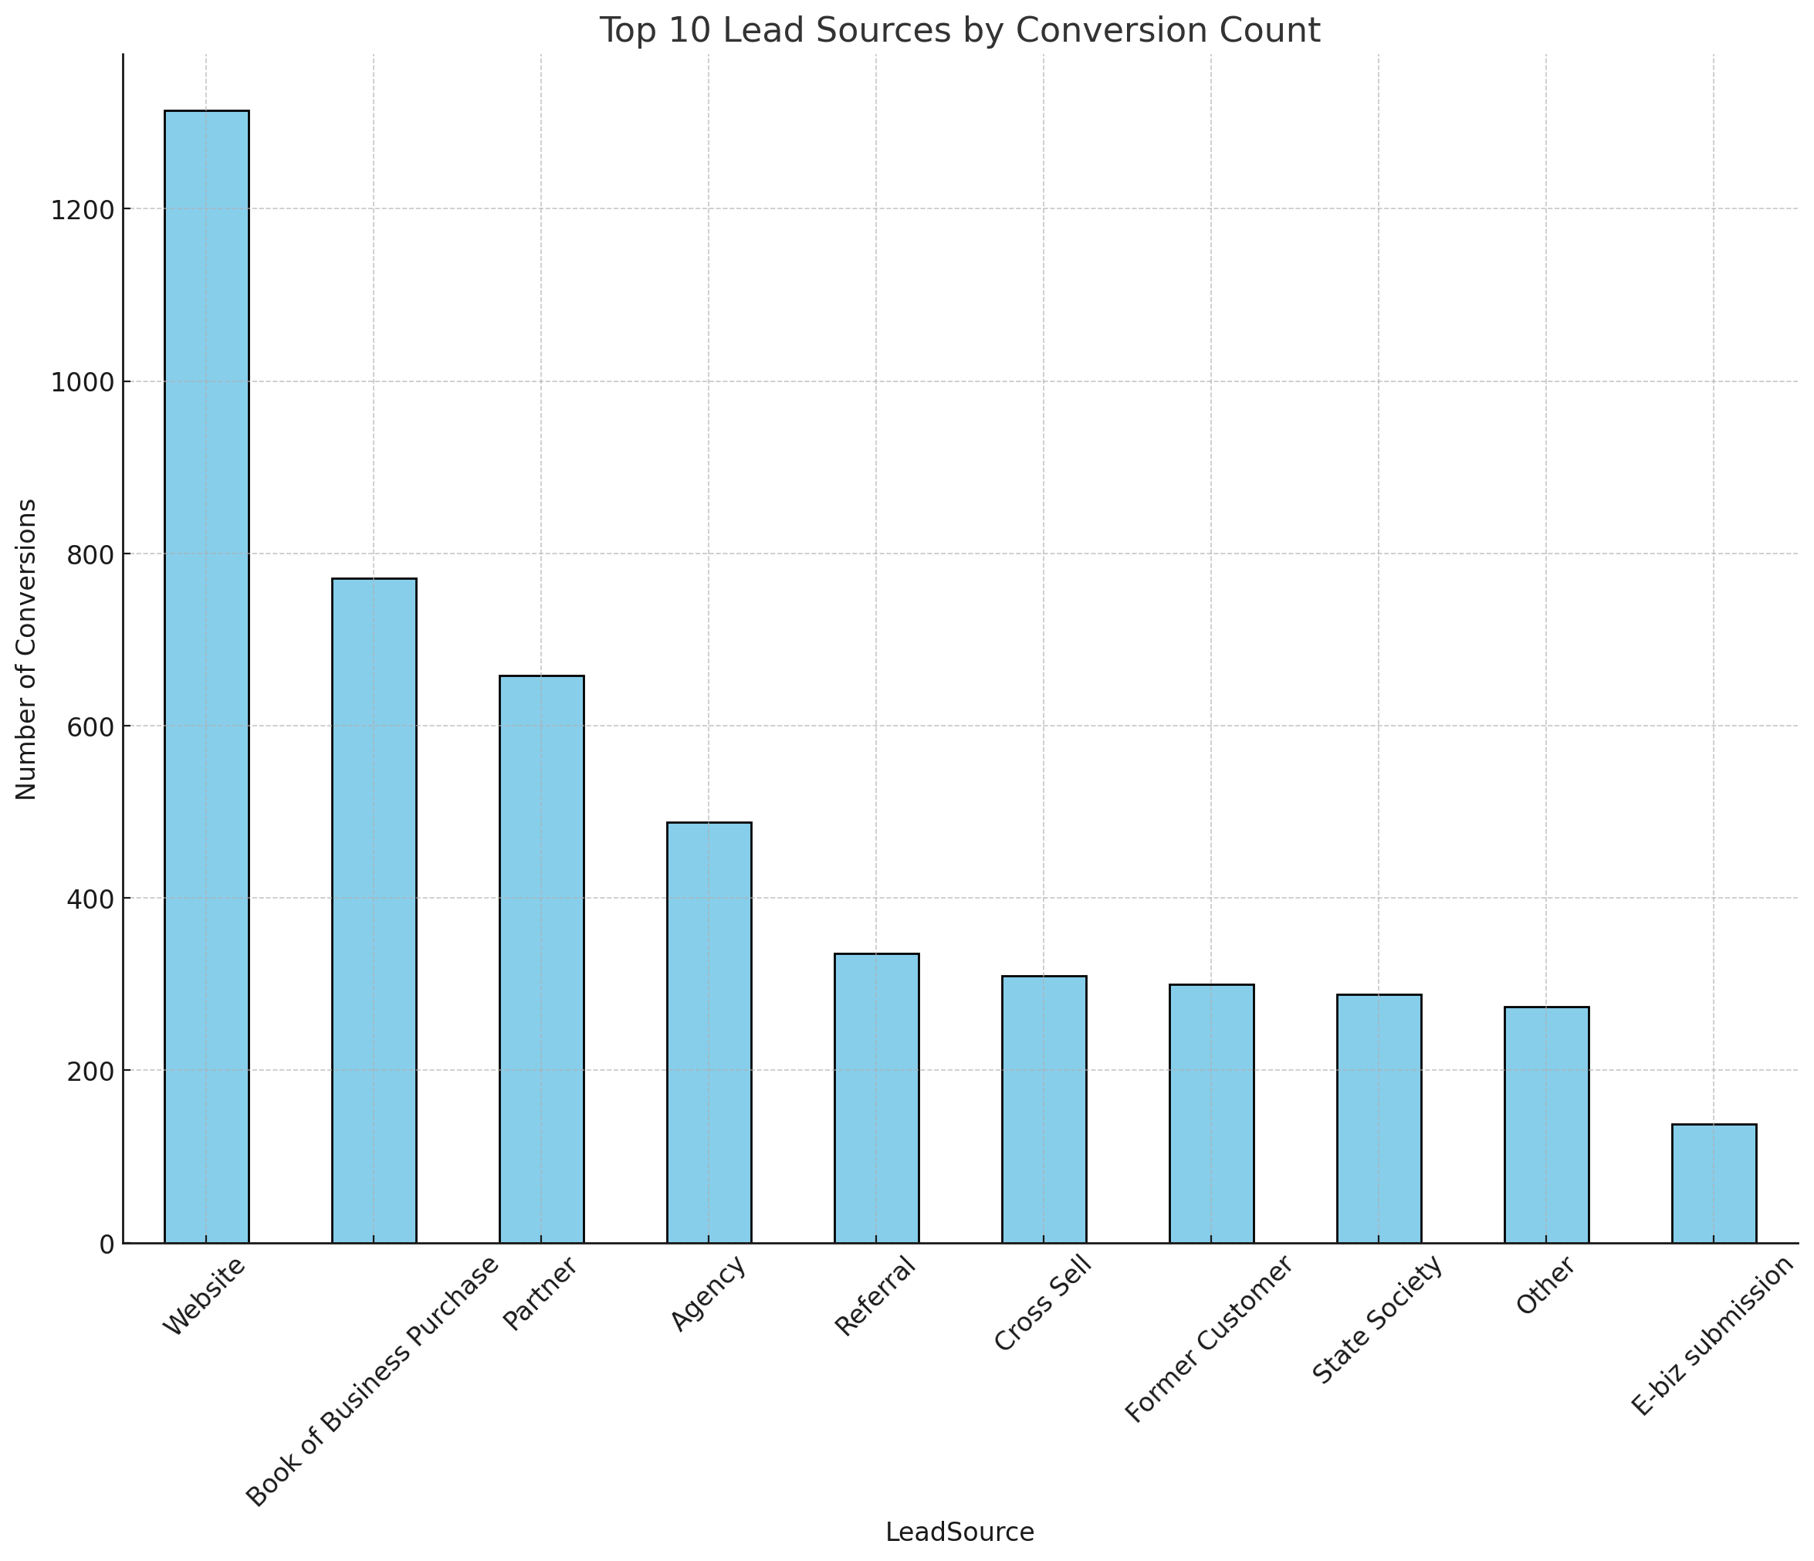
Website is the most effective lead source by a large margin
SEO should be strengthened
Further analytics to replicate website conversion on other sources

Slide 8
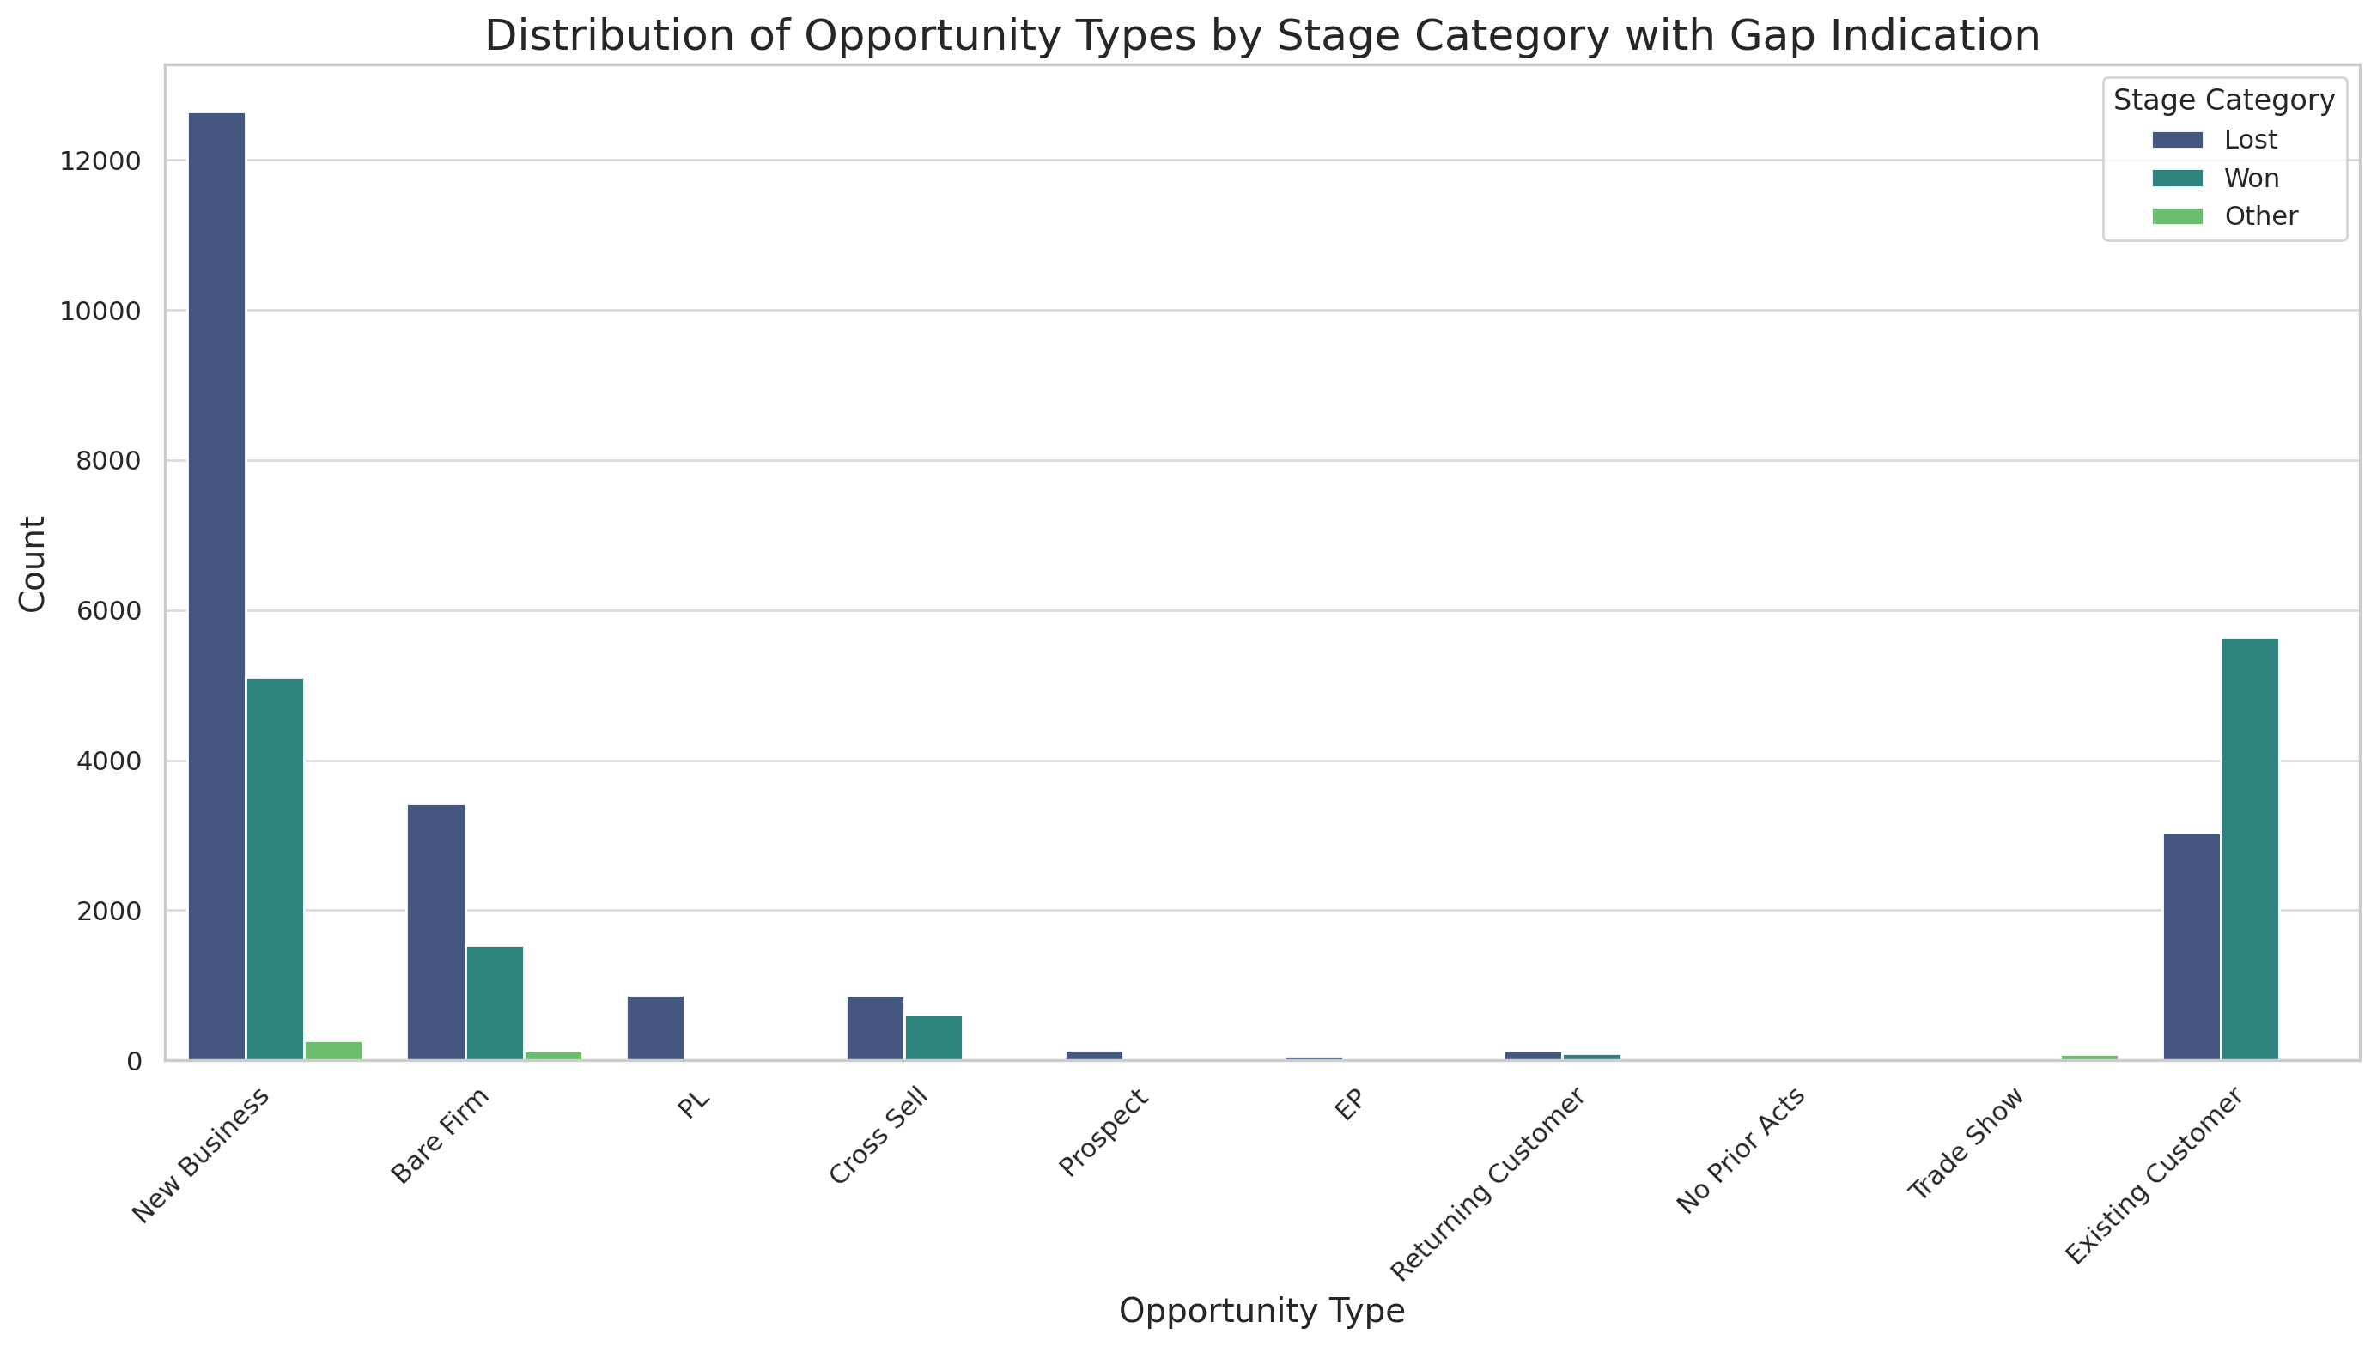

Slide 9
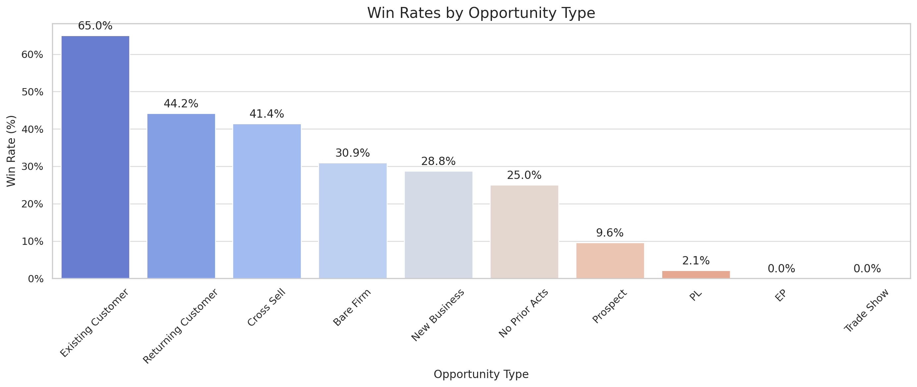
Very successful customer retention indicating strong relationship and effective account management
New customers have moderate win rate, potential area for improvement in customer engagement. This also means lot of leads but not converting effectively
Cross selling and returning customers effectively converted in the prospecting

Slide 10
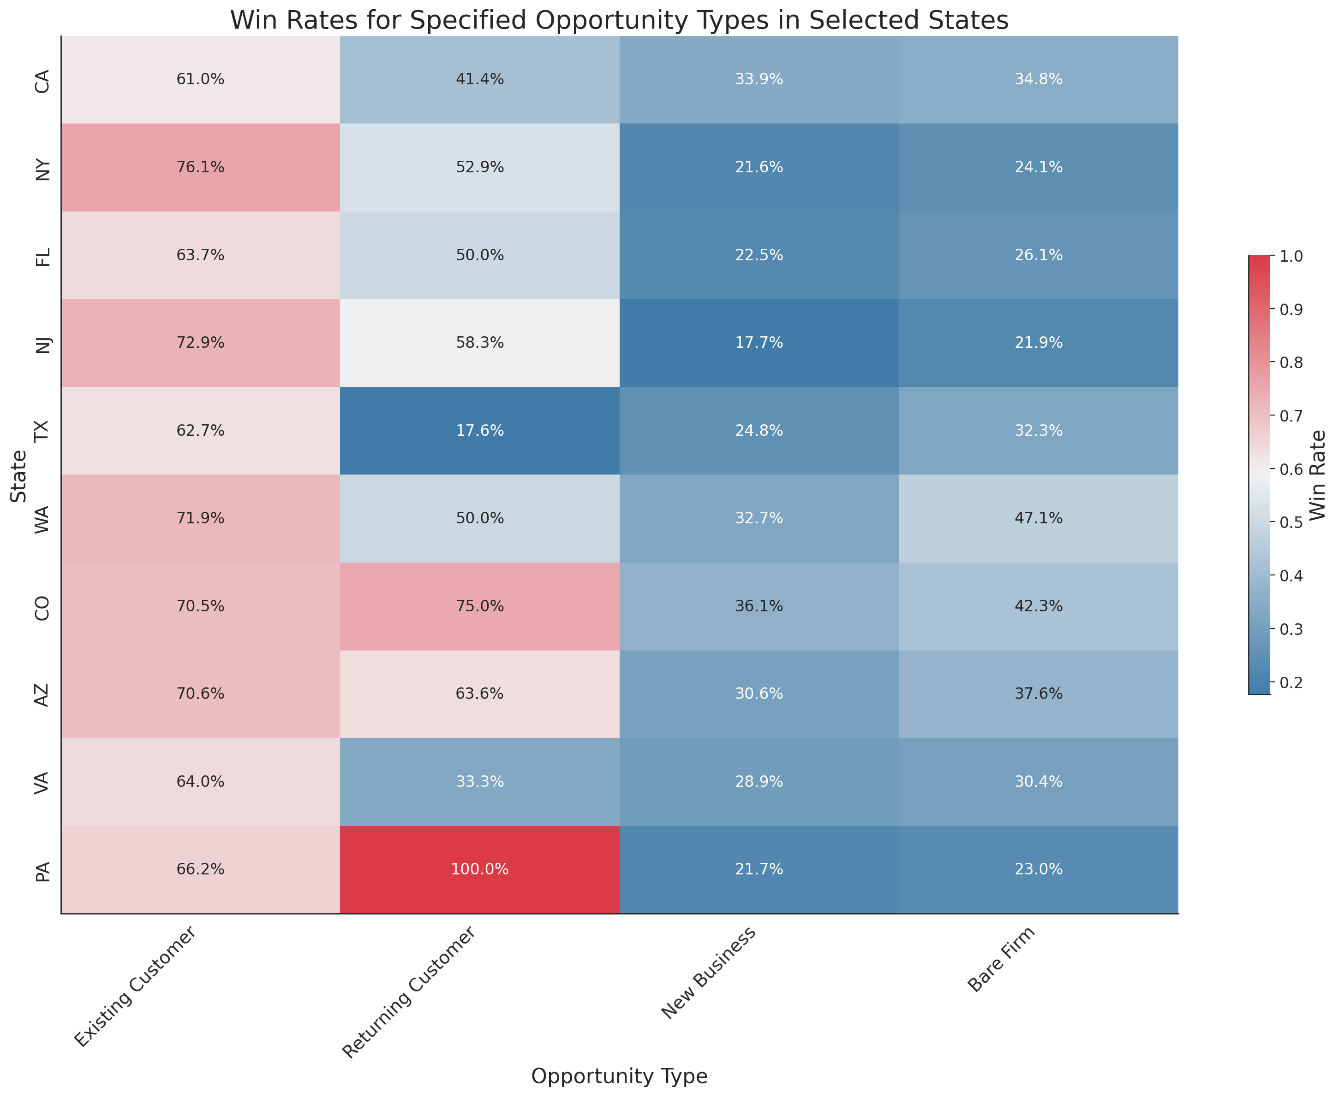
Similar trends across all states
TX and VA not able to win returning customers
CO particularly good with winning new business, apart from CA (home market). CO has fastest growth opportunity with just 4.1% current prospect accounts

Slide 11
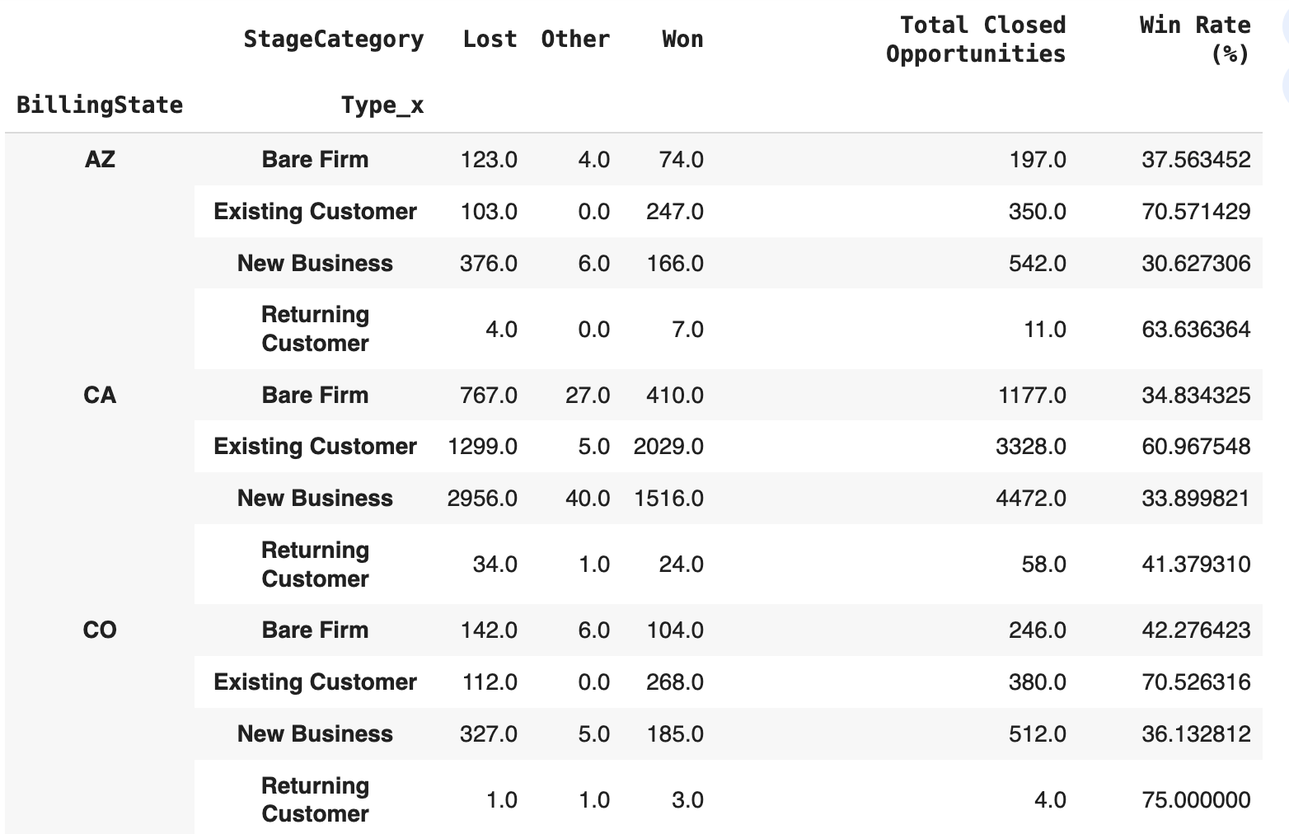
Actual Data for Heatmap

Slide 12
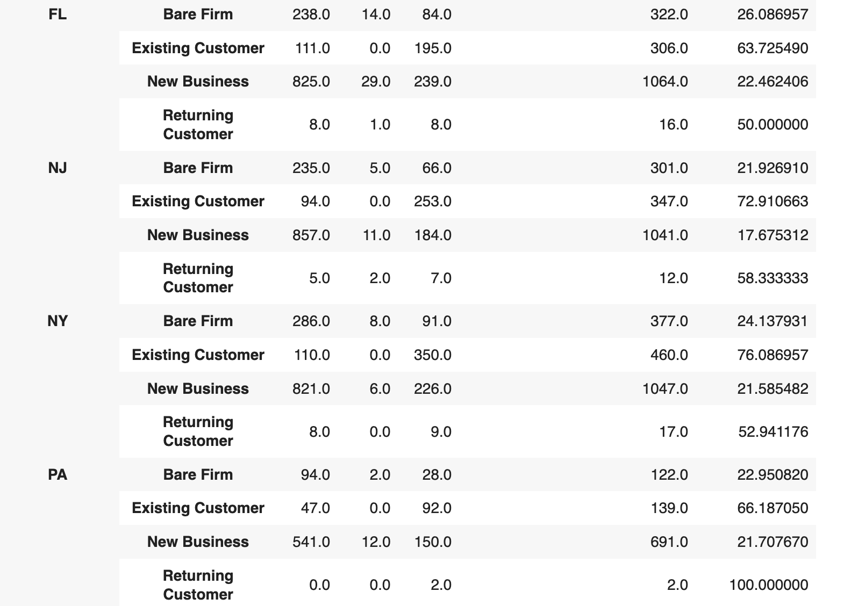
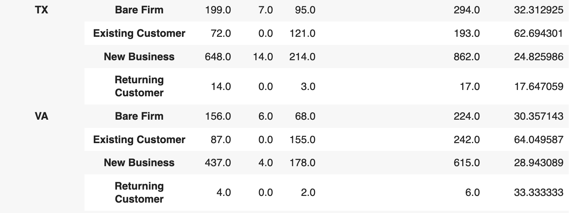

Slide 13
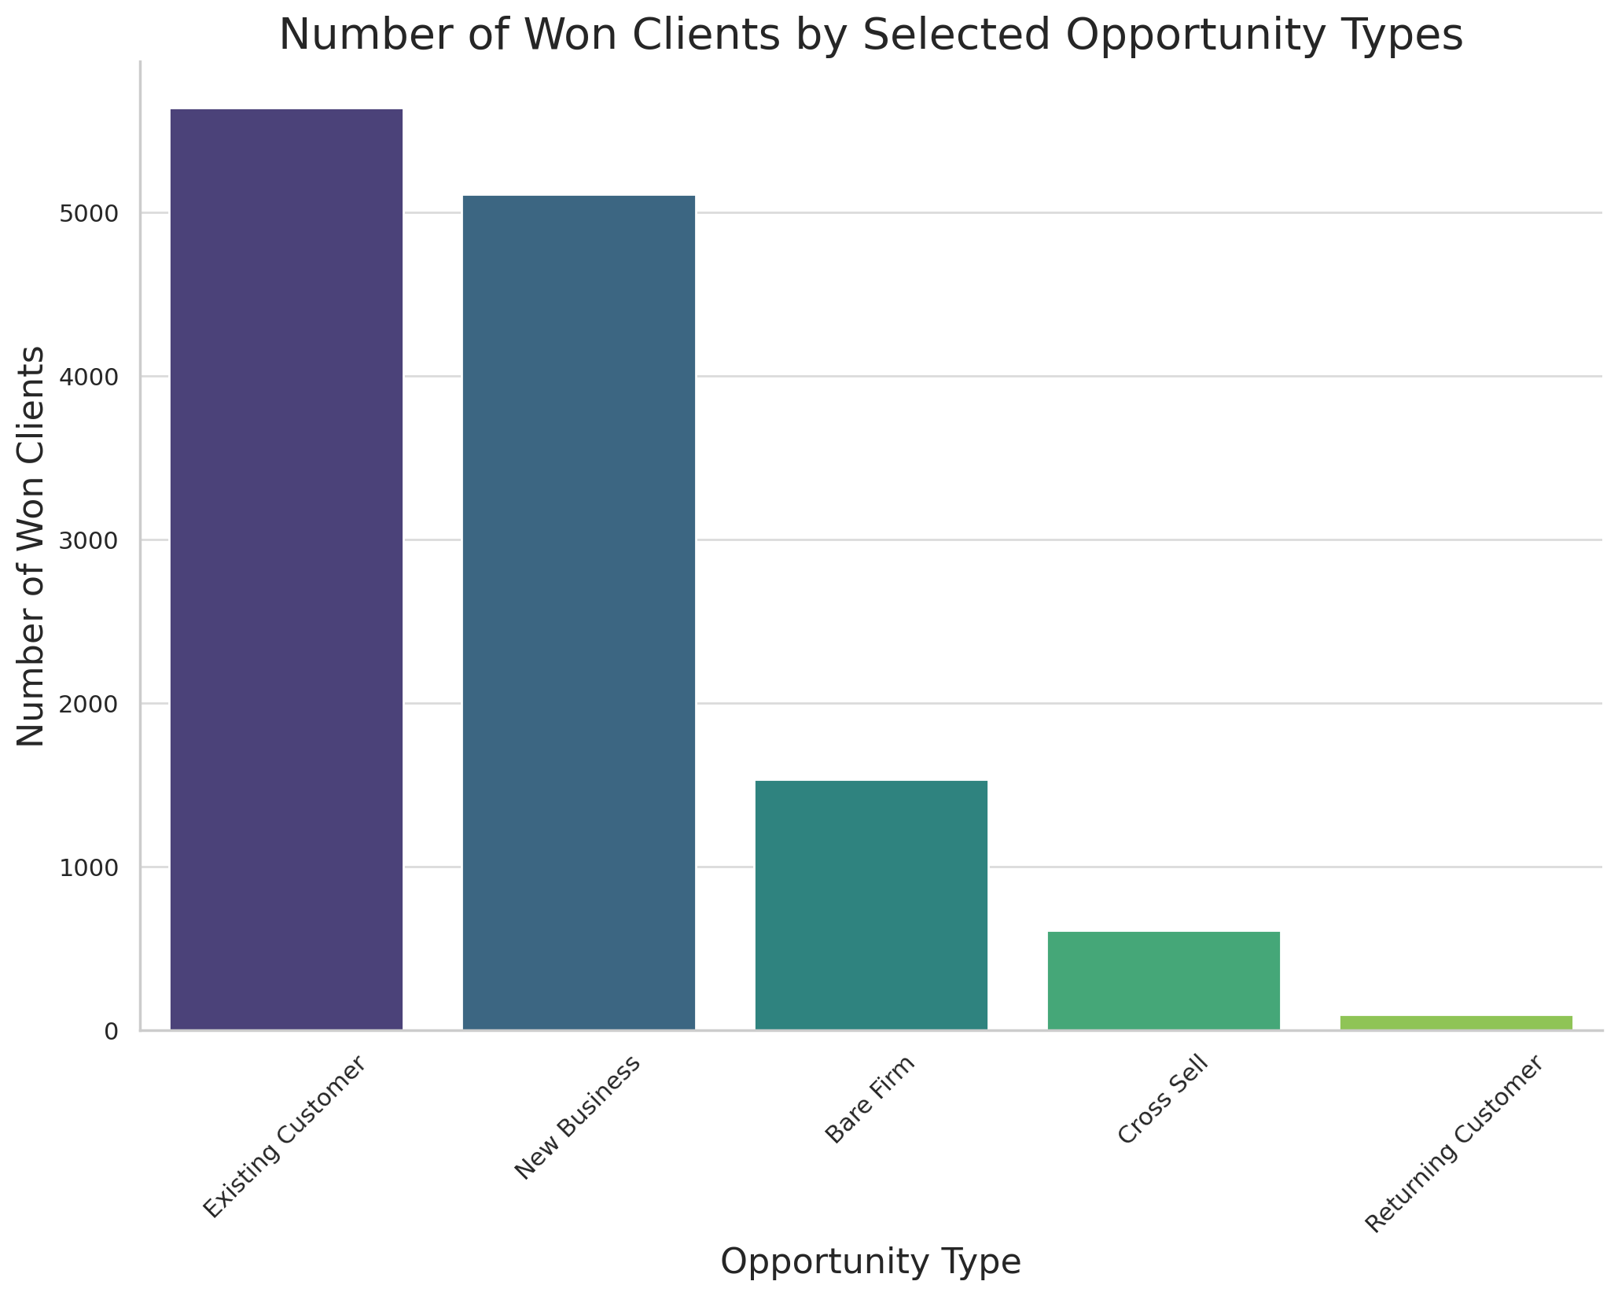

Slide 14
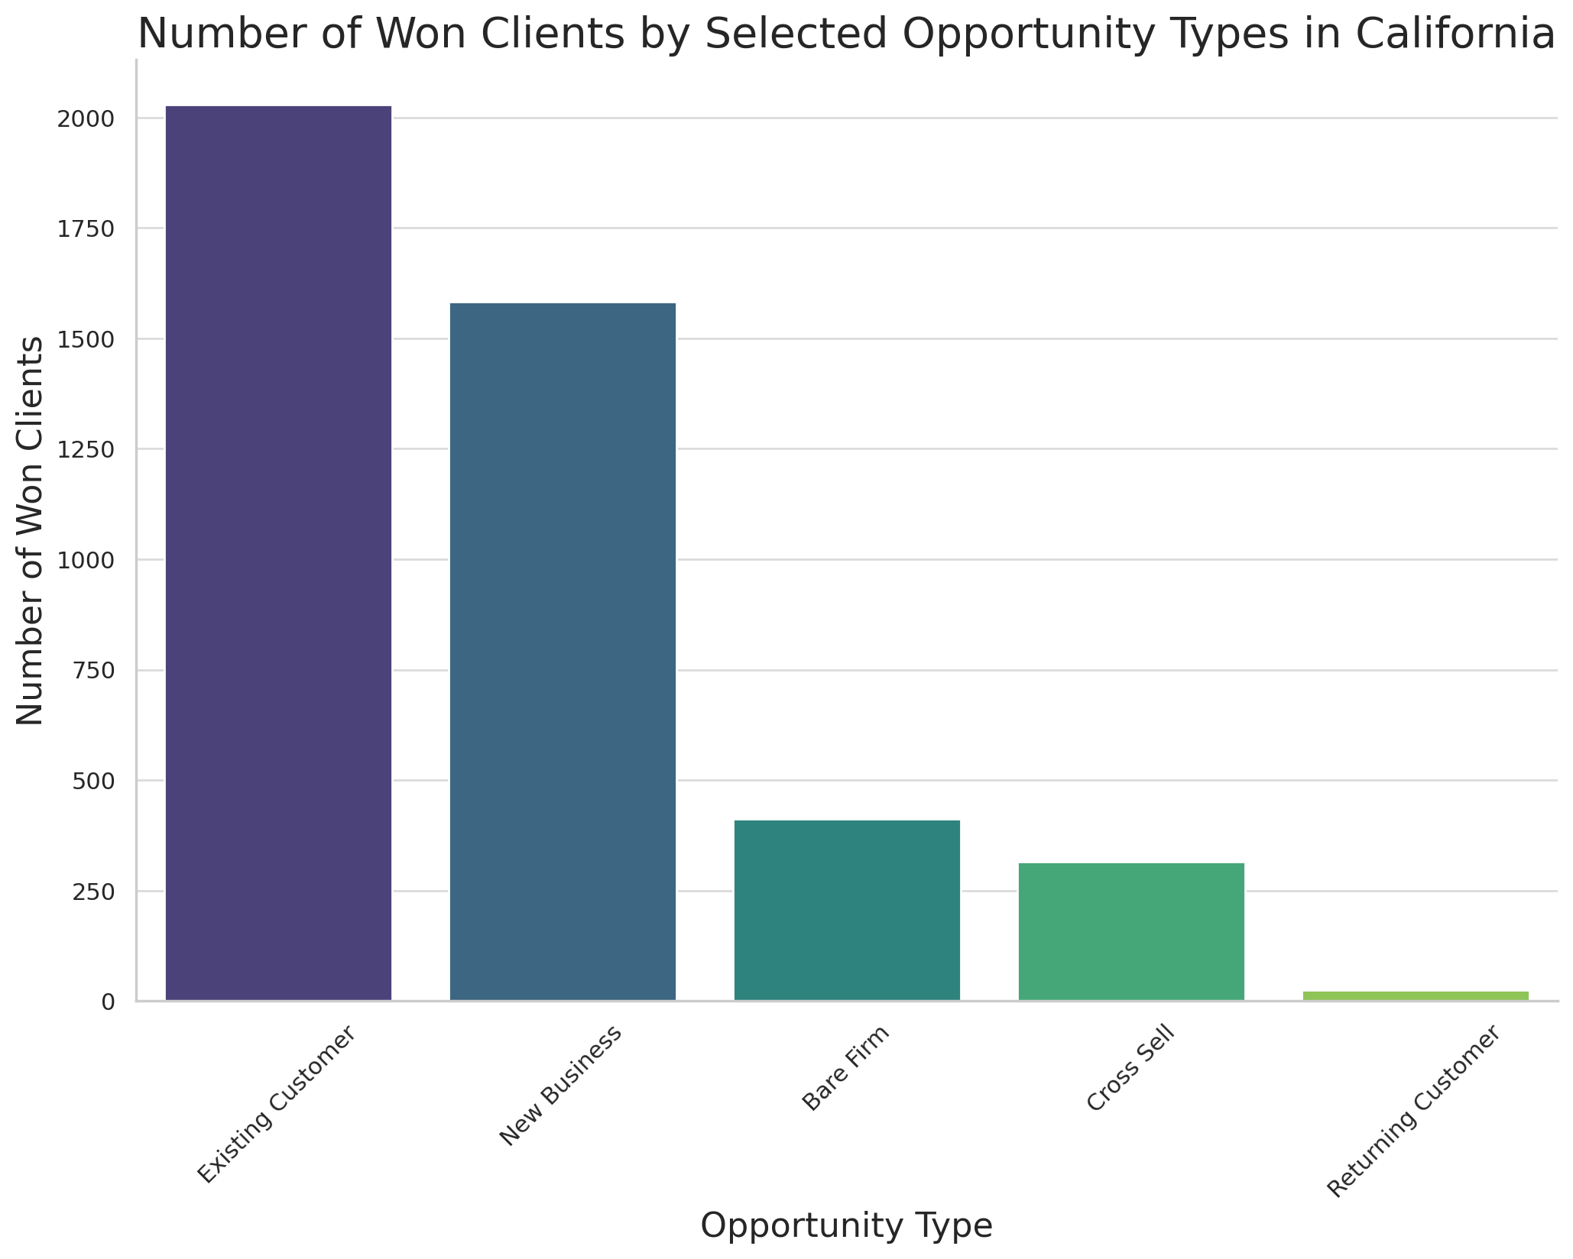

Slide 15
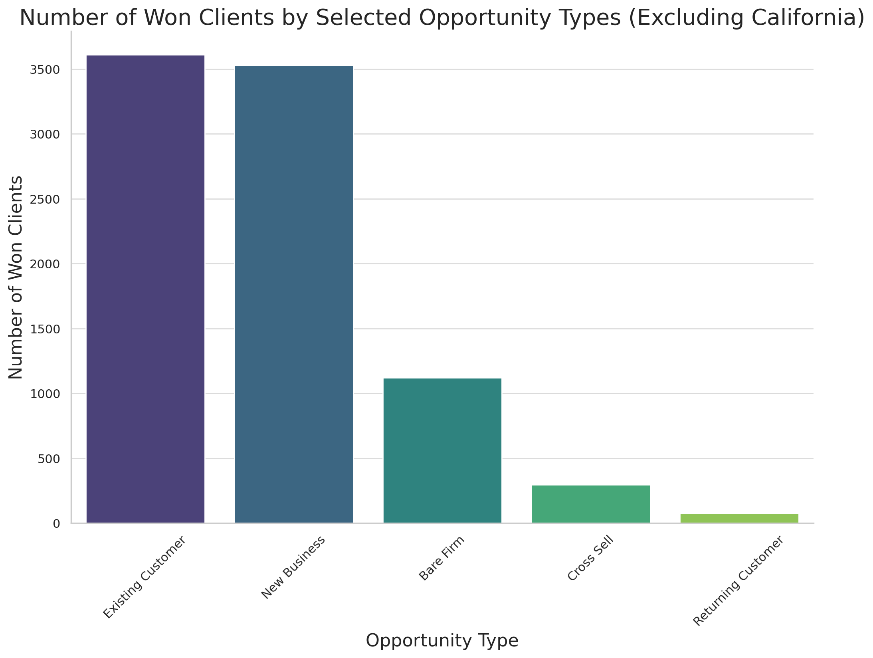

Slide 16
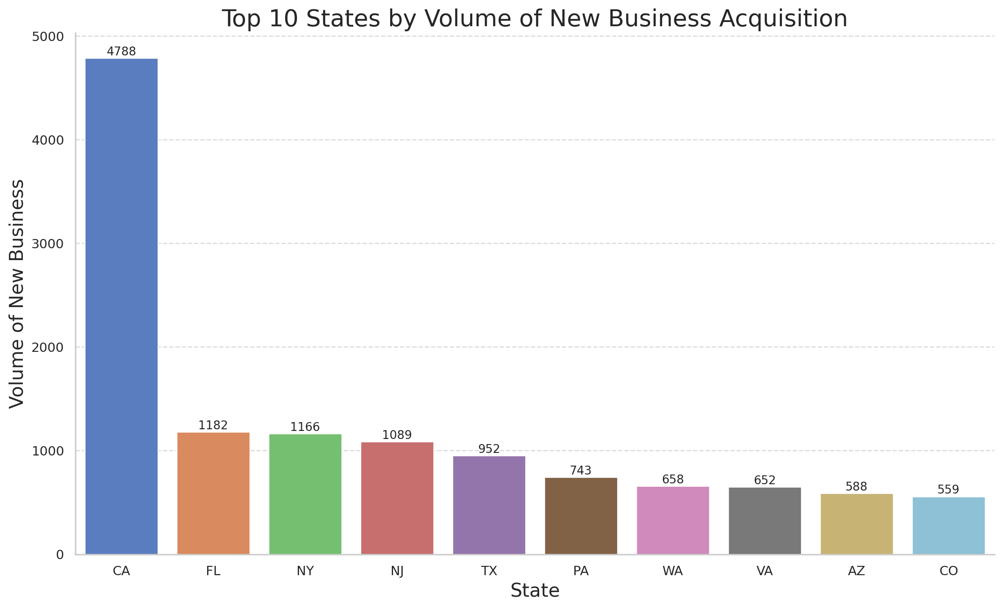
FL very successful in winning New Business with prospect accounts focused towards FL
Expansion in New York Area (NY, NJ) can be made with very little investment

Slide 17
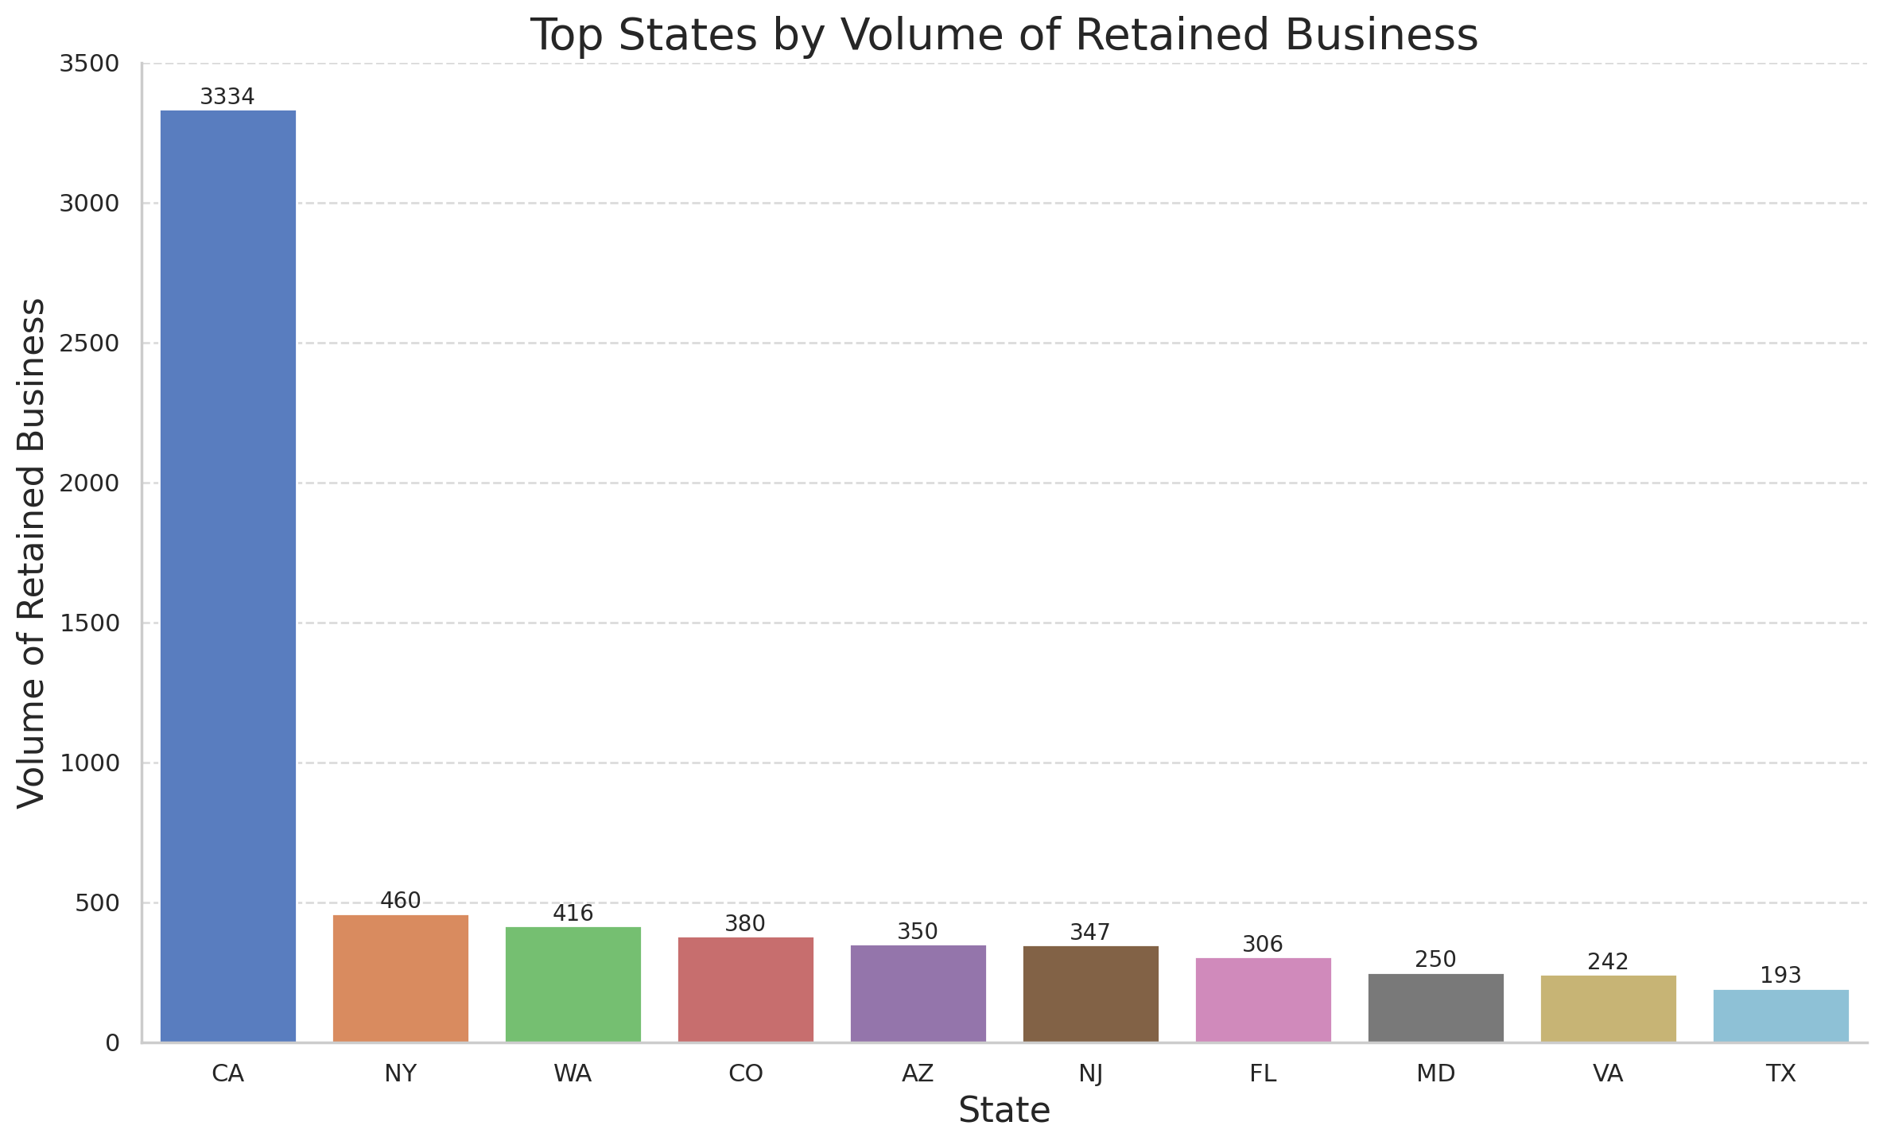

Slide 18
Lead Insights

Slide 19
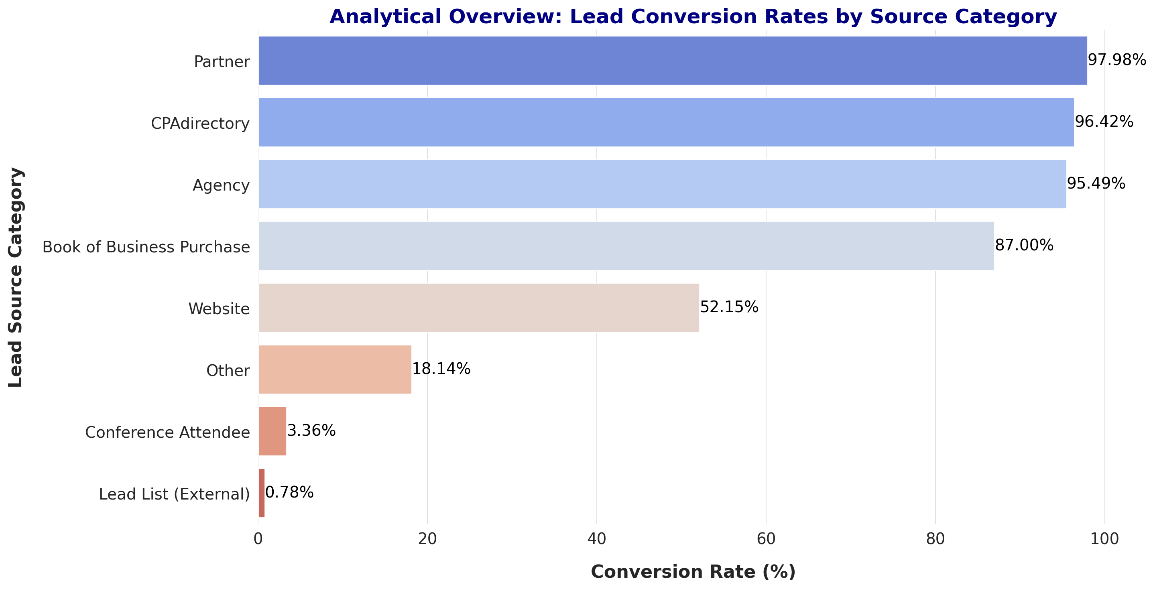

Slide 20
